Slide 1
Orientation and Introduction to HTML
Front-End Web Development

Slide 2
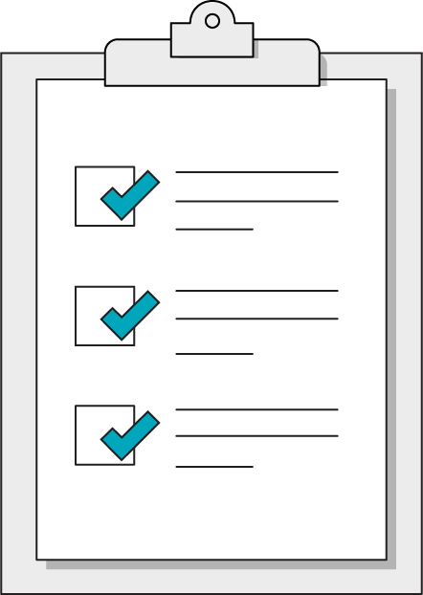
Today’s Learning Objectives
In this lesson, you will:
Create HTML documents using common element tags.
Inspect web pages using the browser’s developer tools.
Describe the relationship between HTML, CSS, and JavaScript in websites.

Slide 3

Tools We’ll Use
Slack for communication
A text editor
Google Chrome
CodePen
Trello for task management

Slide 4

Resources
Stack Overflow for coding questions
CSS-Tricks for CSS/HTML questions
MDN for referencing standards of JS
CodePen for easy code sandboxes
CanIUse.com for browser compatibility checks

Slide 5
What Is Front-End Development?
Content
HTML
Style
CSS
Bones
Skin
Interactivity
JavaScript
Brain

Slide 6
So, What Is HTML?
Front-End Web Development

Slide 7

HTML: Structure for Webpages

Slide 8
HTML Basics
<!DOCTYPE html>
<html>
<head>
<title>GA</title>
</head>
<body>
<p>Hey GA!</p>
</body>
</html>
<html> tag ALWAYS encloses the entire document
The doctype for all HTML documents is the same:
<!DOCTYPE html>. It is ALWAYS the first item on a page.
<head> and <body> tags are where page content go. The <head> contains what machines see, <body> is what people see.

Slide 9
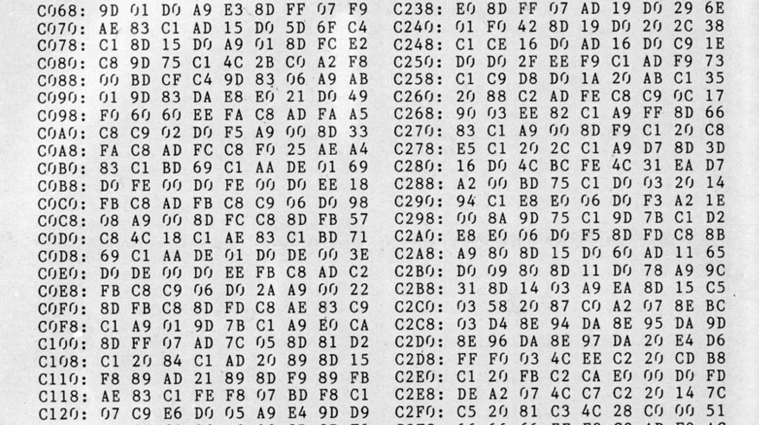
Most People Think HTML Is Programming — It’s Not!

Slide 10
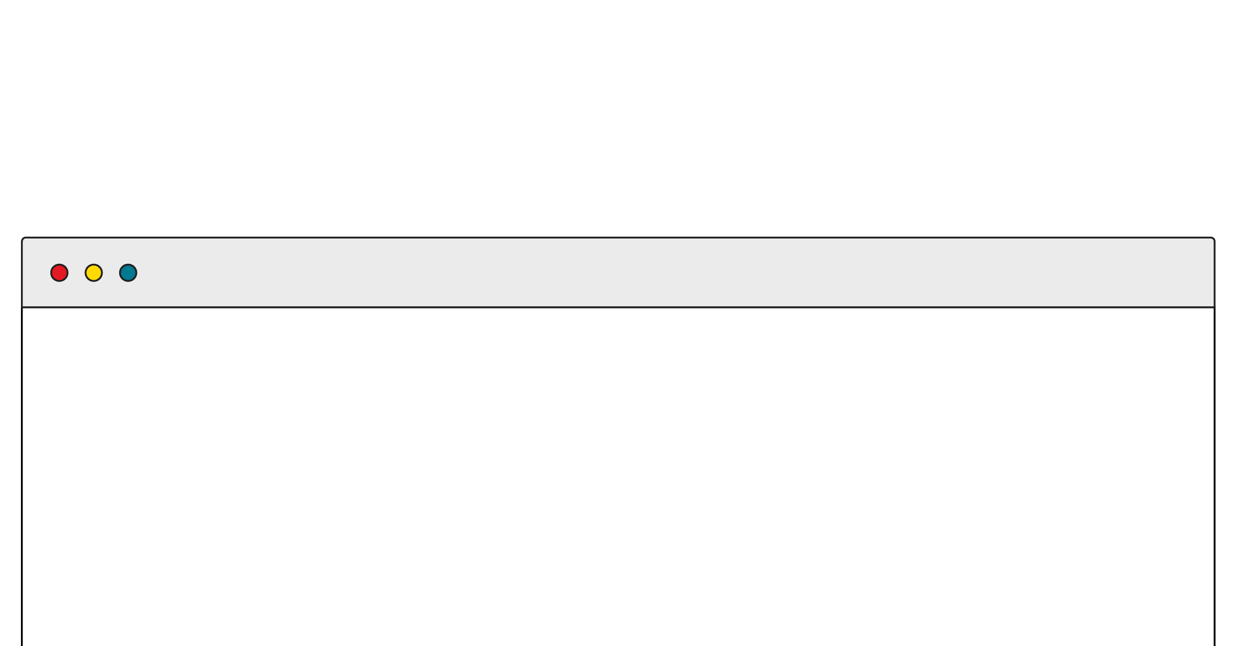
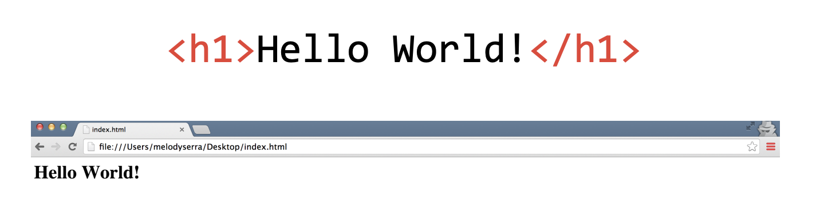
HTML: Hypertext Markup Language
HTML is made up of tags.
Tags tell the browser how to encode the content (e.g., will the content be formatted as an image or as a link?)
< >
These symbols surround every tag.

Slide 11
The Anatomy of HTML
Regular Tags
Self-closing Tags (aka Void Tags)
<p>Hello GA</p>
Opening
Tag
Content
Closing
Tag
<img src="picture.jpg" />
<img src="picture.jpg" alt="A picture">
Tag
Attribute

Slide 12
Attributes
Attributes are additional information we add to an element.
They appear in the opening tag of the element.
They are made up of two parts: a name and a value, separated by “=”.
<a href= “http://www.amazon.com”>Amazon</a>
Name
Value
Href Attribute

Slide 13
HTML Exercises
Front-End Web Development

Slide 14
Hello, Inspector!
10 minutes
Visit one of your favorite websites and identify three HTML tags used within it.
To view the HTML structure of a page using Google Chrome, simply right click on any element on the page and choose “Inspect.” This will open the DevTools panel (this is your new world!) and allow you to view and edit the HTML structure underlying the page.
Then, you might use resources such as W3Schools to get a sense of what the tag means and its most common use cases.
‹#› | © 2020 General Assembly

Slide 15
Structure of HTML
Front-End Web Development

Slide 16

Visualize Your HTML Tags as a Tree

Slide 17
Elements Can Have Parents, Children, and Siblings
<body>
<h1>
<ul>
<li>
<li>
<li>

Slide 18
Common Tags
Element | Description | Example
h1 | Main headings | <h1>The Explorer</h1>
h2–h6 | Subheadings | <h2>Articles</h2>
p | Paragraph of text | <p>This is a really cool site.</p>
a | Anchor tag for links to other web addresses | <a href=”google.com”> Search for stuff </a>
img | Images | <img src=”pic.jpg”>

Slide 19
Common HTML Tags: Lists
Element | Description | Example
li | List item | <ul> <li>Monday</li> <li>Tuesday</li> <li>Wednesday</li> </ul>
ul | Unordered list
ol | Ordered list | <ol> <li>Monday</li> <li>Tuesday</li> <li>Wednesday</li> </ol>

Slide 20
Tags in the Document Head
Element | Description | Example
link | Links a CSS style sheet. | <link href=”css/style.css”>
title | Website title that shows up in the browser tab. | <title>My website</title>

Slide 21
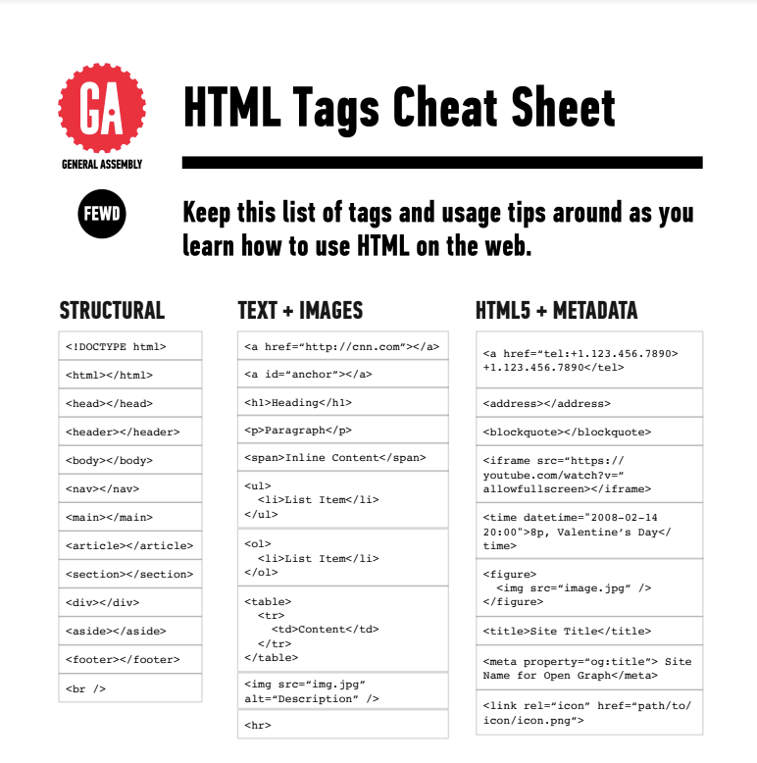
Cheat Sheet: HTML Elements
We’re providing a handy cheat sheet to reference HTML elements here.
The “Structural” and “Text/Image” lists in the cheat sheet are a good place to start when learning HTML. Forms will come later.

Slide 22
Let’s Recreate This Slide in HTML!
10 minutes
Hypertext Markup Challenge
Using the following HTML tags, recreate the contents of this slide, not including the teal title portion. Tags you should use include:
<h1>
<p>
<ul>
<li>

Slide 23
Bovine
Let’s tag an article together!
Our steps are:
Link the HTML, Images, and CSS
Add the content to the html
Tag the content

Slide 24
Kasserole
30 Minutes
Your goal is to experiment with formatting content in HTML. Fork the CodePen as your own. Then, code away! Add the hyperlinks properly, reference the image, create metadata, and get a real webpage going.
Starter code:
https://codepen.io/GAmarketing/pen/RwwyPLw
Solution code:
https://codepen.io/GAmarketing/pen/MWWGwoO

Slide 25
Cookie Time
30 Minutes
Follow the directions in the CodePen to add HTML tags to the given document. Think about the common tags we’ve seen. You can also sneak a peek at the CSS for a glimpse ahead at how style is applied to specific tags!
Starter code:
https://codepen.io/GAmarketing/pen/abbGvNe
Solution code:
https://codepen.io/GAmarketing/pen/jOOxbMK
‹#› | © 2020 General Assembly

Slide 26
Key Takeaways
For Next Time
HTML Is Content
Style!
Tags define and describe the content on a webpage.
Elements are related to each other via parent, child, and sibling relationships.
CSS will add style to our HTML elements.
CSS rules use selectors to select specific HTML tags to style.
‹#› | © 2020 General Assembly

